Slide 1
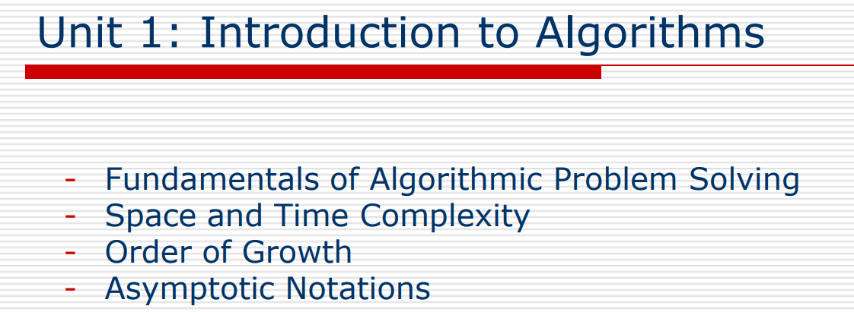
CY43/CI43 – DAA

Slide 2
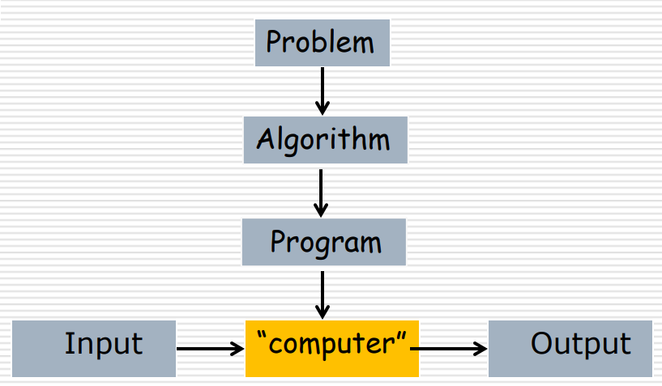
Algorithm
An algorithm is a sequence of unambiguous instructions for solving a computational problem, i.e., for obtaining a required output for any legitimate input in a finite amount of time.

Slide 3
Examples of Algorithms
Computing Greatest Common Divisor of Two non-negative, not-both zero Integers
gcd(m, n): the largest integer that divides both m and n
Euclid’s Algorithm:
gcd(m, n) = gcd(n, m mod n

Slide 4
Greatest Common Divisor (Euclid’s Algorithm), gcd(m, n)
Step 1: If n = 0, return value of m as the answer and stop; otherwise, proceed to Step 2.
Step 2: Divide m by n and assign the value of the remainder to r.
Step 3: Assign the value of n to m and the value of r to n. Go to Step 1

Slide 5
Pseudocode for (Euclid’s Algorithm), gcd(m, n)
ALGORITHM Euclid(m, n)
// Computes gcd(m, n) by Euclid’s algorithm
// Input: Two nonnegative, not-both-zero integers m and n
//Output: Greatest common divisor of m and n
while n ≠ 0 do
r = m mod n
m = n
n = r
return m
Question: GCD(50, 30) how many division Operations are required to compute GCD using Euclid algorithm ?

Slide 6
Middle-school procedure, gcd(m, n)
Step 1: Find prime factors of m.
Step 2: Find prime factors of n.
Step 3: Identify all common prime factors of m and n
Step 4: Compute product of all common factors and return product as the answer.

Slide 7
Consecutive Integer Checking, gcd(m, n)
Step 1: Assign the value of min(m, n) to t.
Step 2: Divide m by t. If the remainder is 0, go to Step 3; otherwise, go to Step 4.
Step 3: Divide n by qt If the remainder is 0, return the value of t as the answer and stop; otherwise, proceed to Step 4.
Step 4: Decrease the value of t by 1. Go to Step 2.

Slide 8
Algorithm Analysis
Same problem, but different algorithms, based on different ideas and having dramatically different speeds.

Slide 9
C++ Program - Analysis of the methods to find the GCD of two numbers
#include<iostream.h>
#include<conio.h>
#include<time.h>
long int euclid(long int m,long int n)
{
clock_t start,end;
start=clock();
long int r;
while(n!=0)
{
r=m%n;
m=n;
n=r;
}
end=clock();
cout<<endl<<"Time
taken:"<<(end-start)/CLK_TCK<<" sec";
return m;
}

Slide 10
Contd…..
long int con(long int m,long int n)
{
clock_t start,end;
start=clock();
long int t,r,g;
if(m>n)
{ t=n; }
else
{ t=m; }
a:do
{
r=m%t;
if(r!=0)
t--;
} while(r!=0);
if(r==0)
{
r=n%t;
if(r==0)
g=t;
else
{
t--;
goto a;
}
}
end=clock();
cout<<"Time taken :"<<(endstart)/CLK_TCK<<" sec";
return g;
} /*End of the function con*

Slide 11
Contd…. Analysis of 2 algorithms
void main()
{
long int x,y;
clrscr();
cout<<"\t\t ANALYSIS OF THE TWO ALGORITHMS"<<endl<<endl;
cout<<"GCD - EUCLID'S ALG : "<<endl;
cout<<"enter two numbers:";
cin>>x>>y;
cout<<endl<<endl<<"GCD : "<<euclid(x,y);
cout<<endl<<endl<<"------------------------------------------------";
cout<<endl<<endl<<"GCD - CONSECUTIVE INTEGER CHECKING ALG :
"<<endl<<endl;
cout<<endl<<endl<<"GCD : "<<con(x,y);
getch();
}

Slide 12
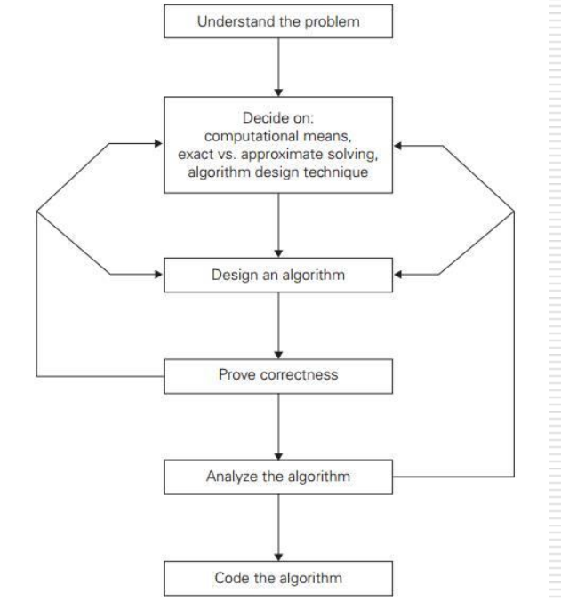
Fundamentals of Algorithmic Problem Solving
Sequence of steps in the process of design and analysis of algorithms

Slide 13
Understanding the problem
Ask questions, do a few small examples by hand, think about special cases, etc.
An input is an instance of the problem the algorithm solves
Specify exactly the set of instances the algorithm needs to handle
Decide on
Exact vs. approximate solution
Approximate algorithm: Cannot solve exactly, e.g., extracting square roots,
solving nonlinear equations, etc.
Appropriate Data Structure

Slide 14
Analyze algorithm
Time efficiency: How fast it runs
Space efficiency: How much extra memory it uses
Simplicity: Easier to understand, usually contains fewer bugs, sometimes simpler is more efficient, but not always.
Coding algorithm
Write in a programming language for a real machine
Standard tricks:
Compute loop invariant (which does not change value in the loop) outside loop
Replace expensive operation by cheap ones.

Slide 15
Analysis of Algorithms
Reasons to Analyze Algorithms
Predict Performance
Compare Algorithms
Provide Guarantees
Understand theoretical basis.
Primary Practical Reason: Avoid Performance Bugs

Slide 16
Performance measure of the algorithm
Two kinds of efficiency:
Space Efficiency or Space Complexity
Time Efficiency or Time Complexity

Slide 17
Two kinds of Algorithm Efficiency
Analyzing the efficiency of an algorithm (or the complexity of an algorithm) means establishing the amount of computing resources needed to execute the algorithm.
There are two types of resources:
• Memory space. It means the amount of space used to store all data processed by the algorithm.
• Running time. It means the time needed to execute all the operations specified in the algorithm.
Space efficiency: Deals with the space required by the algorithm
Time efficiency: It indicates how fast an algorithm runs.

Slide 18
What is Space complexity?
For any algorithm, memory is required for the following purposes
Memory required to store program instructions
Memory required to store constant values
Memory required to store variable values
Space complexity of an algorithm can be defined as follows
Total amount of computer memory required by an algorithm to complete its execution is called as space complexity of that algorithm

Slide 19
What is Space complexity?
Generally, when a program is under execution it uses the computer
memory for THREE reasons.
They are:
Instruction Space: It is the amount of memory used to store compiled version of instructions.
Data Space: It is the amount of memory used to store all the variables and constants.
Environmental Stack: It is the amount of memory used to store information of partially executed functions at the time of function call.
Space Complexity= Instruction space + Data space + Stack space

Slide 20
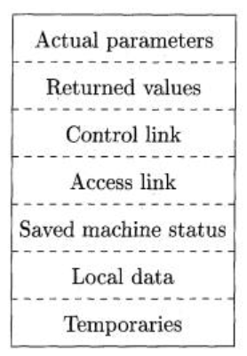
Stack Allocation of Space
Temporary values, such as those arising from the evaluation of expressions, in cases where those temporaries cannot be held in registers.
A saved machine status, with information about the state of the machine just before the call to the procedure. This information typically includes the return address (value of the program counter, to which the called procedure must return).
An "access link" may be needed to locate data needed by the called procedure but found elsewhere, e.g., in another activation record.
A control link, pointing to the activation record of the caller.
The actual parameters used by the calling procedure. Commonly, these values are not placed in the activation record but rather in registers, when possible, for greater efficiency.

Slide 21
Calculating Space Complexity
To calculate the space complexity, we must know the memory required to store different datatype values (according to the compiler). For example, the C Programming Language compiler requires the following.
1 byte to store Character value,
2 bytes to store Integer value,
4 bytes to store Floating Point value,
6 or 8 bytes to store double value

Slide 22
Calculating Space Complexity
Calculating the Data Space required for the following given code
int square(int a)
{
return a*a;
}
Data Space Required:
For int a → 2 Bytes
For returning a*a → 2 Bytes
Total 4 Bytes
Data Space Required:
This code requires 2 bytes of memory to store variable 'a' and another 2 bytes of memory is used for return value.
That means, totally it requires 4 bytes of memory to complete its execution. And this 4 bytes of memory is fixed for any input value of 'a'. This space complexity is said to be Constant Space Complexity.
If any algorithm requires a fixed amount of space for all input values then that space complexity is said to be Constant Space Complexity.

Slide 23
Performance measure of the algorithm
What is Time complexity?
Every algorithm requires some amount of computer time to execute its instruction to perform the task. This computer time required is called time complexity.
Time complexity of an algorithm can be defined as follows.
The time complexity of an algorithm is the total amount of time required by an algorithm to complete its execution

Slide 24
What is Time complexity?
Generally, running time of an algorithm depends upon the following.
Whether it is running on Single processor machine or Multi processor
machine.
Whether it is a 32 bit machine or 64 bit machine
Read and Write speed of the machine.
The time it takes to perform Arithmetic operations, logical operations, return value and assignment operations etc.,
Input data

Slide 25
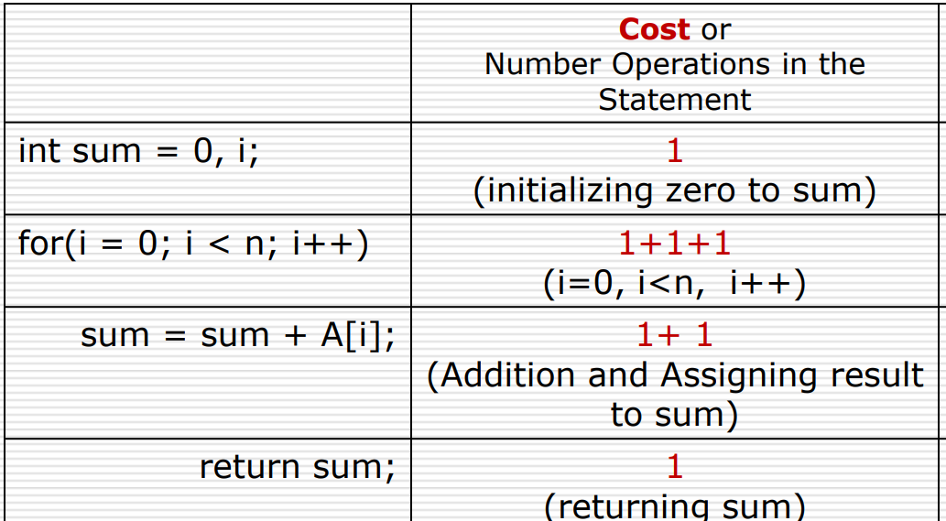
Calculating Time Complexity

Slide 26
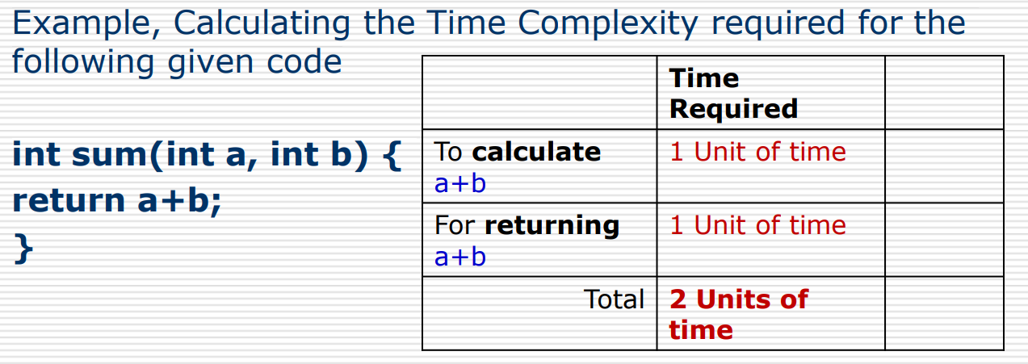
Calculating Time Complexity
If any program requires fixed amount of time for all input values then its time complexity is said to be Constant Time Complexity.

Slide 27
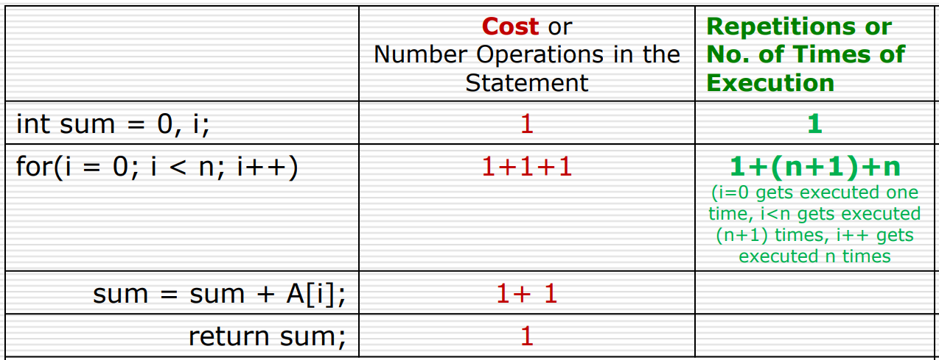
Calculating Time Complexity

Slide 28
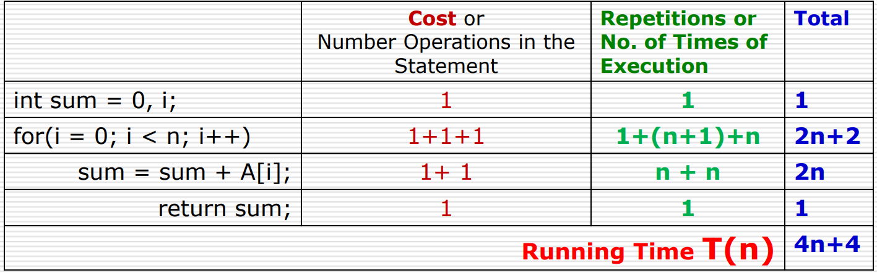
Calculating Time Complexity

Slide 29
Calculating Time Complexity
Cost is the amount of computer time required for a single operation in each line.
Repetition is the amount of computer time required by each operation for all its repetitions.
Total is the amount of computer time required by each operation to execute.
So above code requires '4n+4' Units of computer time to complete the task. Here the exact time is not fixed. And it changes based on the n value. If we increase the n value then the time required also increases linearly.
Totally it takes '4n+4' units of time to complete its execution and it is Linear Time Complexity.
If the amount of time required by an algorithm is increased with the increase of input value then that time complexity is said to be Linear Time Complexity

Slide 30
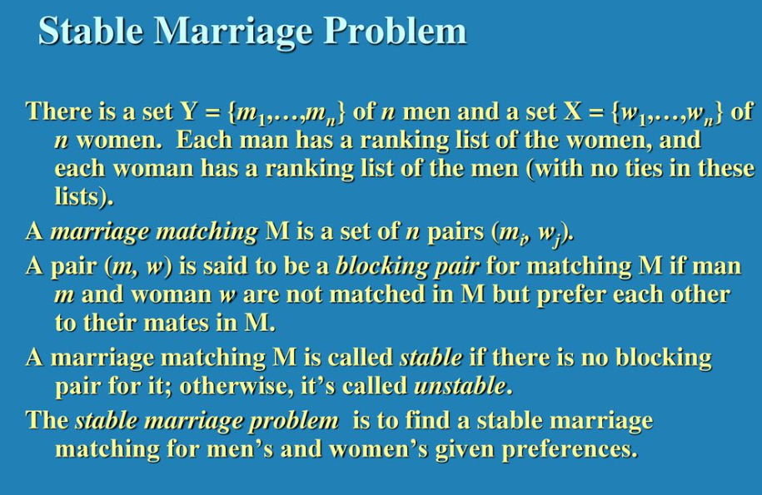

Slide 31
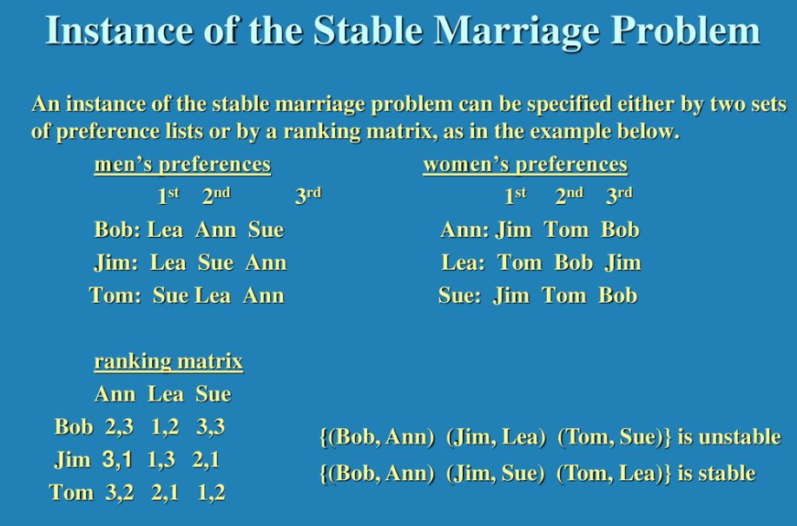

Slide 32
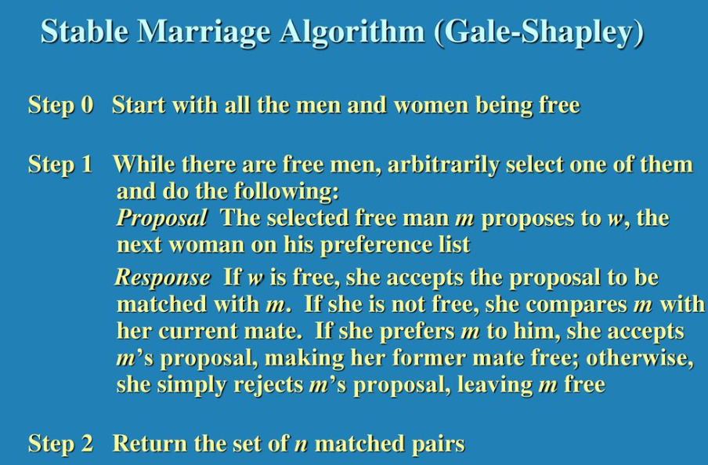

Slide 33
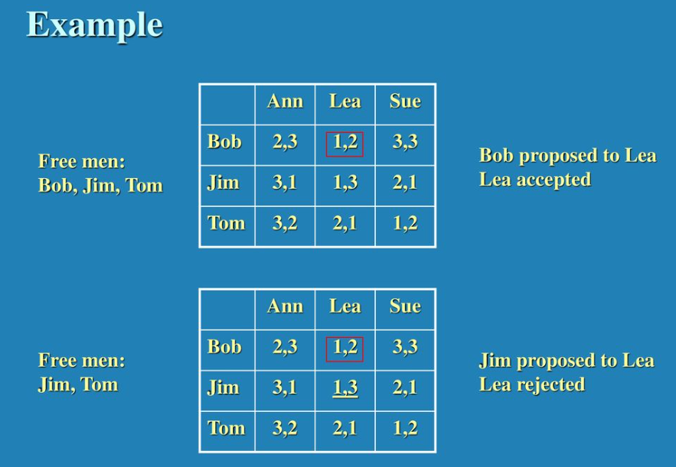

Slide 34
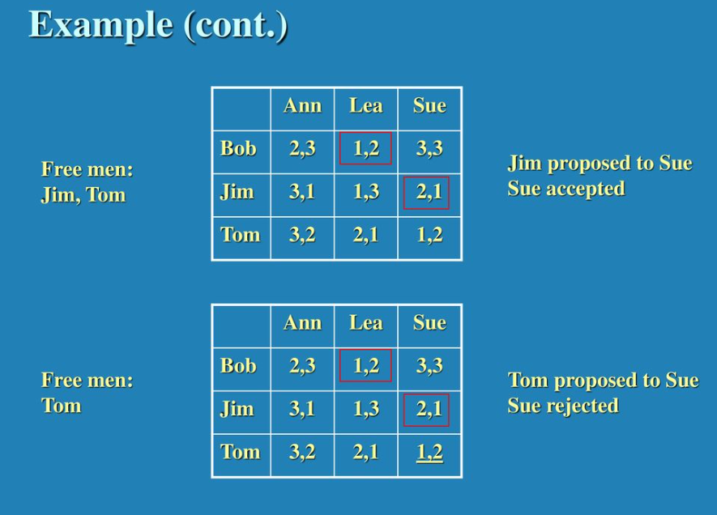

Slide 35
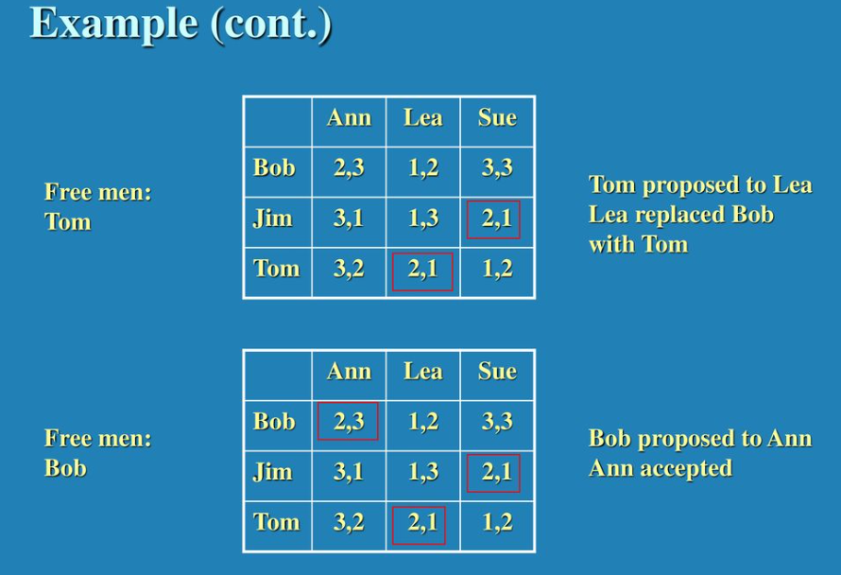

Slide 36
